Slide 1
Purchase & Shipping Analysis Dashboard
A Data-Driven Approach to Business Insights
Presented by: Riya Kumari

Slide 2
The Business Challenge (Problem Statement)
Businesses struggle to analyze large, complex purchase and shipping data.
Raw data is difficult to interpret, slowing down decision-making for managers.
The need: A simple, visual dashboard is required to easily view and understand key data insights.

Slide 3
Project Objectives (Our Goals)
The main goal was to create a clear and interactive Excel dashboard that:
Visually shows purchase and shipping trends in an easy-to-understand format.
Helps managers make better business decisions based on real data insights.
Improves the speed and accuracy of business reporting for growth.

Slide 4
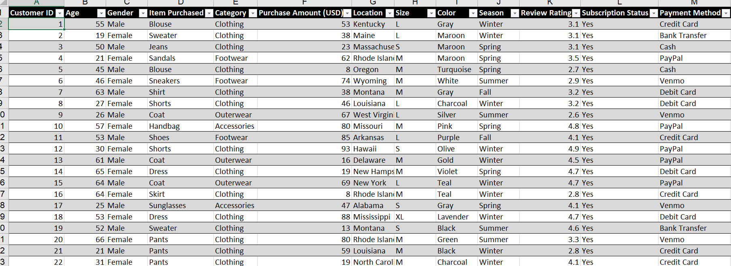
Raw Data Overview
The analysis was based on raw data in Excel format, including columns such as:
Core Details: Date, Customer ID, Category, Item, Purchase Amount, and Payment Method.
Customer Preferences: Color, Size, and Gender.

Slide 5
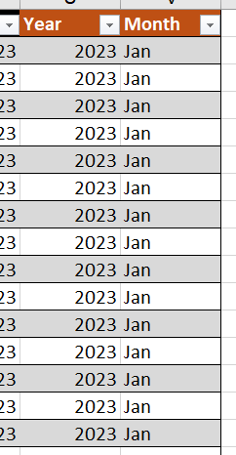
Data Preparation: Cleaning & Structuring
To ensure data accuracy, the following steps were taken:
The raw data was converted into an Excel Table.
Missing, wrong, and duplicate values were removed.
Errors in spelling and formatting were corrected in key columns like Category and Payment Method.
New columns were added for time-based analysis:
Year (using the formula =YEAR([Date])).
Month (using the formula =TEXT([Date],"mmm")).

Slide 6
Data Analysis: Pivot Tables & Metrics
Pivot Tables were created to effectively summarize and analyze the data.
They calculated total purchases by category and identified the Top 10 items by purchase amount.
They also compared monthly purchases and analyzed data by gender, size, color, and payment method.
Key Performance Indicators (KPIs) were calculated:
Total Purchase Value and Total Items Purchased.
Sales performance by Category (Accessories, Clothing, Footwear, Outerwear).
Year-on-Year percentage change was calculated to track growth trends.
All key values were linked to the Pivot Table data for automatic updates.

Slide 7
Dashboard Design & Key Metrics
A dedicated "Dashboard" worksheet was created with a clean look (gridlines removed, tab color changed).
KPI Boxes were designed using rounded rectangles and icons for a modern, professional appearance.

Slide 8
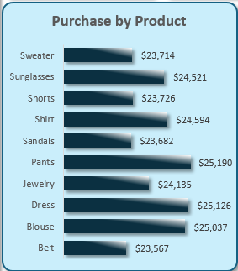
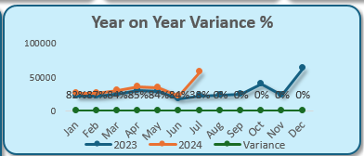
Sales Performance by Product & Time
Purchase by Product (Bar Chart):
Highest Value Items: Pants, Dress, and Blouse.
Lower Sales Items: Sweater and Belt (potential areas for improvement).
Year-on-Year Comparison (Line Chart):
Monthly sales compared for 2023 and 2024.
Sales variance was strong (above 80%) from January to July, but dropped after August

Slide 9
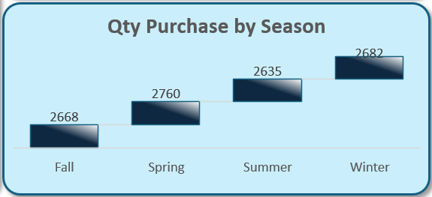
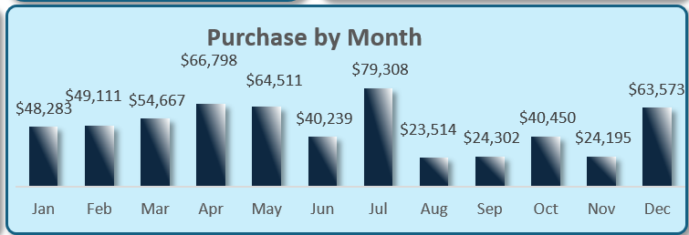
Seasonal & Monthly Purchase Trends
Quantity Purchase by Season (Waterfall Chart):
Purchases slightly increased from Fall (2668) to Spring (2760).
A small dip occurred in Summer (2635), followed by the highest quantity in Winter (2682).
Purchase by Month (Column Chart):
Peak Sales Month: July ($79,308).
Low Sales Months: August and November.

Slide 10
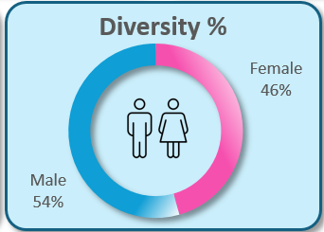
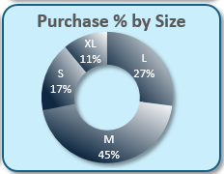
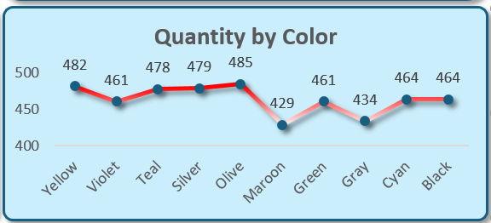
Customer & Product Preferences
Gender Diversity (Donut Chart):
Male: 54% of total purchases.
Female: 46% of total purchases.
Purchase by Size (Donut Chart):
Most Popular Size: M (45%).
Followed by L (27%), S (17%), and XL (11%).
Quantity by Color (Line Chart):
Highest Quantity: Olive (485 purchases).
Lowest Quantity: Maroon (429 purchases).

Slide 11
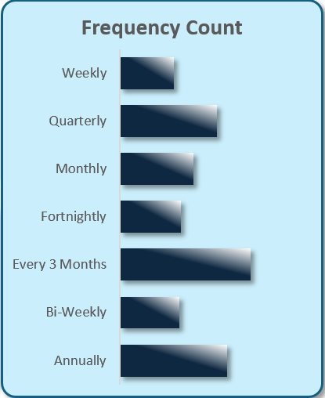
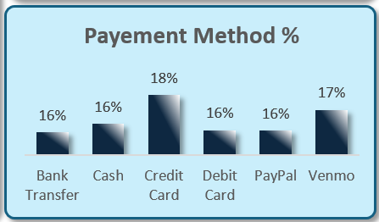
Buying Patterns & Payment
Purchase Frequency (Bar Chart):
Displays the count of transactions for various frequencies like weekly, quarterly, and annually.
Highlights the most common buying patterns to guide strategies.
Payment Method % (Column Chart):
Most Popular: Credit Card (18%).
Second Most Popular: Venmo (17%).
Other methods (Bank Transfer, Cash, Debit Card, PayPal) are used equally (16% each).

Slide 12
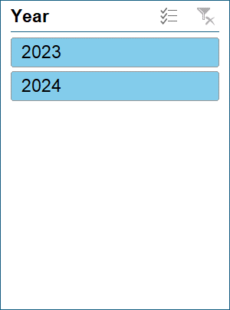
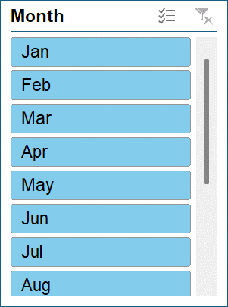
Interactivity & Usability
Slicers were added for Year and Month.
These slicers are connected to all Pivot Tables and Charts.
Benefit: They allow users to quickly filter and view data for any specific period or category, providing instant insights and enhancing usability.

Slide 13
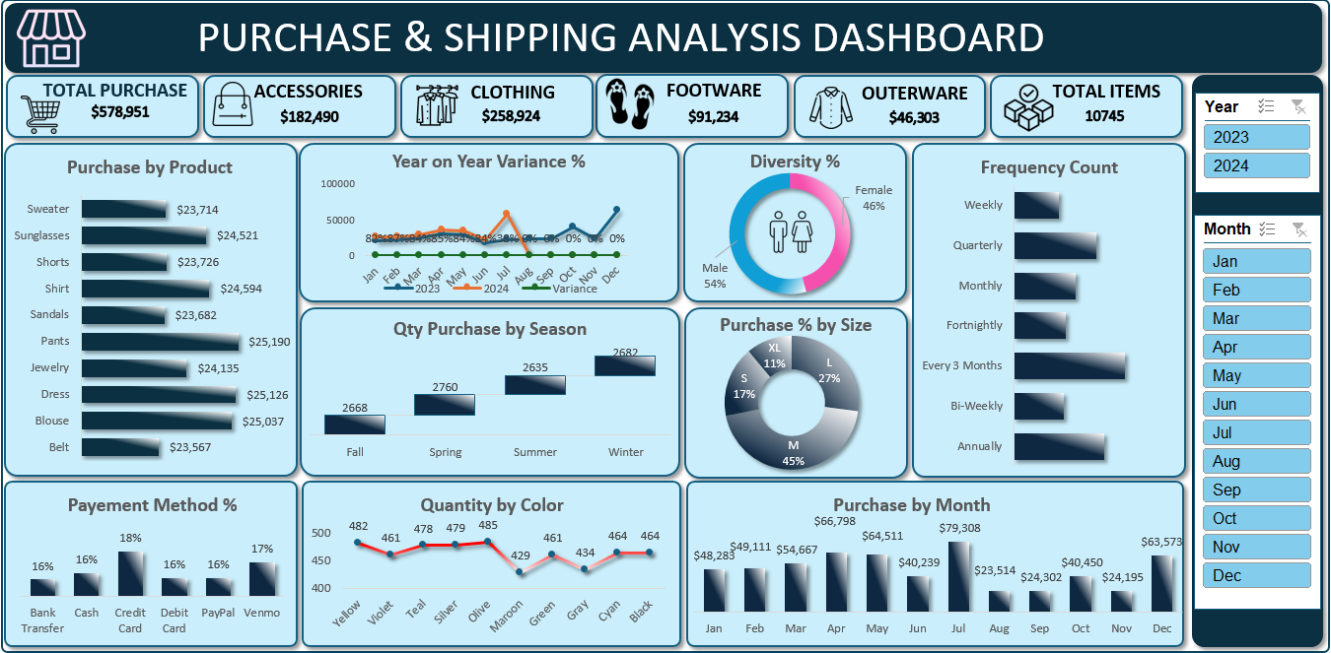
Final Dashboard Demo

Slide 14
Business Insights & Recommendations
Key Insights
Accessories sales increased by 30% in 2023.
Card payments (Credit/Debit) are the most popular method.
Female customers mostly prefer size L.
Clear seasonal and monthly trends influence buying patterns.
Recommendations for Improving Sales
Focus marketing efforts on popular product categories and sizes.
Offer special discounts during high purchase months (like July).
Promote and prioritize preferred payment methods like cards.
Ensure sufficient stock of popular colors (like Olive) to meet demand.

Slide 15
Conclusion
This Excel Dashboard successfully transforms complex data into clear, actionable insights:
It helps in making better, data-driven decisions through clear visuals and interactivity.
It demonstrates strong Excel skills in data preparation, Pivot Tables, charts, and slicers.
The tool provides a simple, user-friendly way to explore trends and patterns in the data.

Slide 16
Thank you

